Slide 1
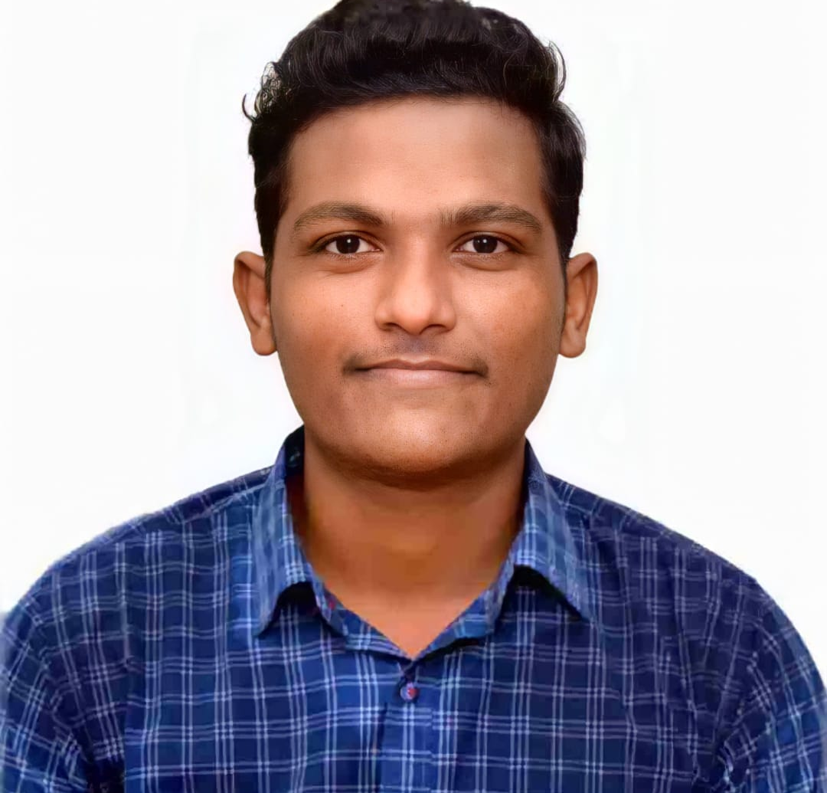



Ganesh Dattatray Khawale
Analyst/Software Engineer
Bachelor of Engineering
Electrical : 2019 - 2022
Skills
Java 8 /J2EE | Java Basics, OOPS, Generics, Collections, Arrays, Loops, Lambda Exp, Stream API Junit, Mockito, Servlets
Spring core | IOC & Dependency Injection, Autowire
Spring REST | REST controllers, Implementation of GET, POST, PUT & DELETE, Bean Validation & Exception Handling, Testing Services, Controller & Repository layer
Spring Data JPA | spring Data repositories
Spring Boot Microservices | Spring Boot Starters, annotations, Messaging Service, Swagger API documents, Email Service
Spring Cloud | Eureka, Netflix Hystrix, Config Server, Spring Gateway
Angular | Components, Services, Modules, Routing, Forms & Validation,
Database | MongoDB My SQL
UI Tech | HTML 5 & CSS 3,JavaScript, TypeScript Reusable templates, Bootstrap
Tools | Git, Postman, Maven, IDE
Add On skills | Communications, Team management. Peer learning, Leadership
Mumbai
ganesh-dattatray.khawale@capgemini.com
+91 9764636532
A4
Full Stack Developer
Hands on experience in creating microservices with Springboot, Spring Security, Spring Cloud API Gateway, Eureka server, External Api gateway
Hands on experience in creating Single page Web Application in Angular, Angular reactive forms, angular routing, CSS, Bootstrap
Experience in creating documentation with swagger and in unit testing using Junit, Mockito including code quality compliance using Sonar cube
Hands on experience of using MongoDB, MySql and PostgresSql database.
Worked on creating apis using NodeJs and familiar with Androidstudio.
Pharmacy Management Application
Completed end to end case study of Pharmacy Management Application along with JWT authentication, Swagger and MongoDb database, responsive UI with CSS, Bootstrap and Angular used for user interface. Using Microservices architecture with spring boot, spring security, springcloud api gateway, Eureka server & external api gateway.
Smart Recruit Mobile
Worked on android application with the use of Angular for frontend and Nodejs for backend with PostgreSql database.
Aws Certified Cloud Practitioner
Check out my work on GitHub & Video Profile

